Slide 1
Data Management

Slide 2
Session Overview
Data Concepts
Data Configuration Management
Data Errors & Data Corruption
Data Files & It's Usage
Data Management
Backup Management
Security Control Management
Data Migration
Understanding and Troubleshooting Data Specific Migration Exceptions
Errors and Troubleshooting
Data Split
In Single User
In a Multiuser scenario
Top Queries in the Data configuration
Company is not listing in Server or client
Attempting to open data files
What is Data Corruption
Why Data gets corrupted
Data Recovery Management
What is Repair and Types of Repair
Malware
Phases of Data Repair
Top Data Errors

Slide 3
Data Management Concepts
Understanding of Data files in Earlier versions
Data File structure and It’s functionalities in release 3.0x

Slide 4
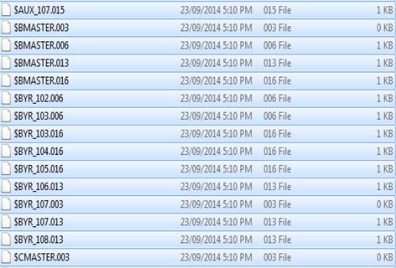
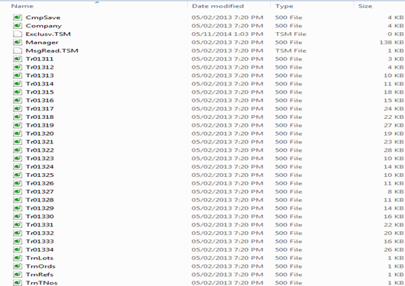
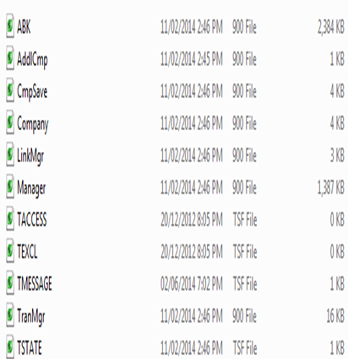
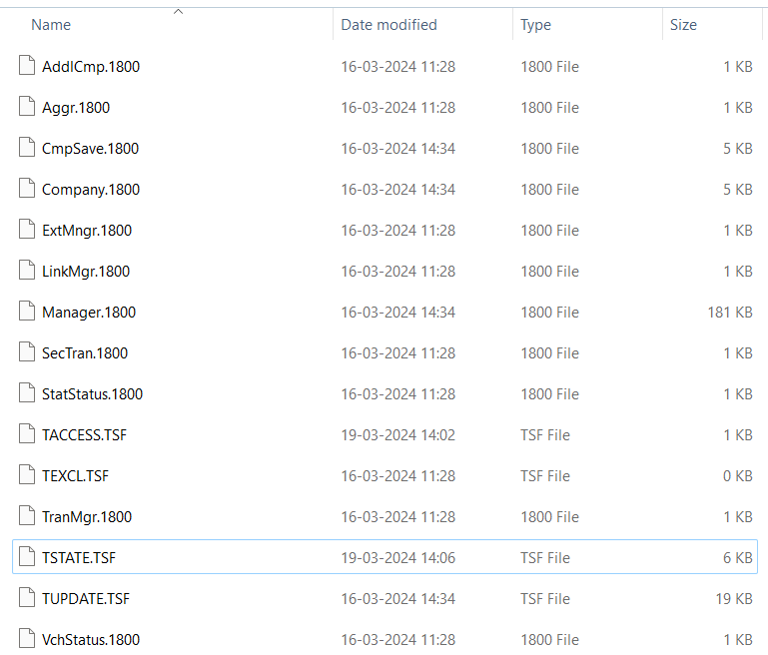
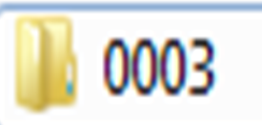

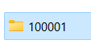
Data Files and Usage(1of3)
Tally 4.5
Tally 5.4/6.3/7.2
Tally 9/ERP/Prime 2.1
TallyPrime 3.0 & above

Slide 5
Data Files and Usage(2of3)
Tally. ERP 9/TallyPrime till rel 2.1 | TallyPrime Rel 3.0 onwards | Behavior
Company.900 Cmpsav.900 | Company.1800 Cmpsav.1800 | This file contains the information of Company Profile with Statutory Info. This file is a Backup of Company.900/1800.
Manager.900 | Manager.1800 | This file consists the master level information like, Groups, Ledgers
LinkMgr.900 | LinkMgr.1800 | This file contains the details of bill references, order numbers, batch
TranMgr.900 | TranMgr.1800 | This file contains the transactions entered
- | Aggr.1800 | Stores the accumulated values for instantaneous stat related report access
 | SecTran.1800 | Stores summary of transactions corresponding to /Exchange/Export/Return Transactions for both accounting and statutory
 | Status.1800 | Status information(for e.g. Include status/Exclude status etc) for both vouchers as well as stat

Slide 6
Data Files and Usage(3of3)
Tally. ERP 9/TallyPrime till rel 2.1 | TallyPrime Rel 3.0 onwards | Behavior
TACCESS.TSF | TACCESS.TSF | TACCESS.TSF files are used while accessing the reports. This file has the control of read request and write request.
TEXCL.TSF | TEXCL.TSF | For synchronizing access to data among multiple clients for exclusive operations(like migration/repair/split/Import/sync etc..
TMESSAGE.TSF | TMESSAGE.TSF | This file consists the information of masters/vouchers created, and information is pushed to database as per the nature of information.
TSTATE.TSF | TSTATE.TSF | Stores the actual status of the data
Tupdate.TSF | Tupdate.TSF | Used for ensuring handling when there is a failure during transaction write-out by a client.
 | TINTMSG.TSF | Message Queue for special operations like recomputation

Slide 7
Data Management
Backup Management
Security Control
Data Migration
Migration Exceptions

Slide 8
Backup Management

Slide 9
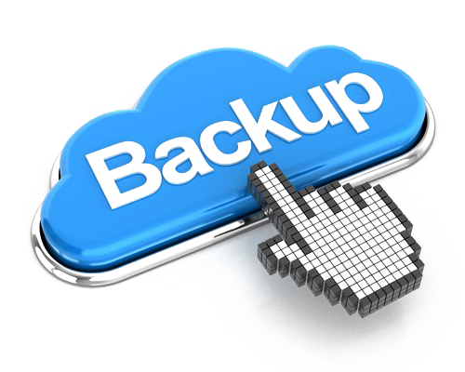
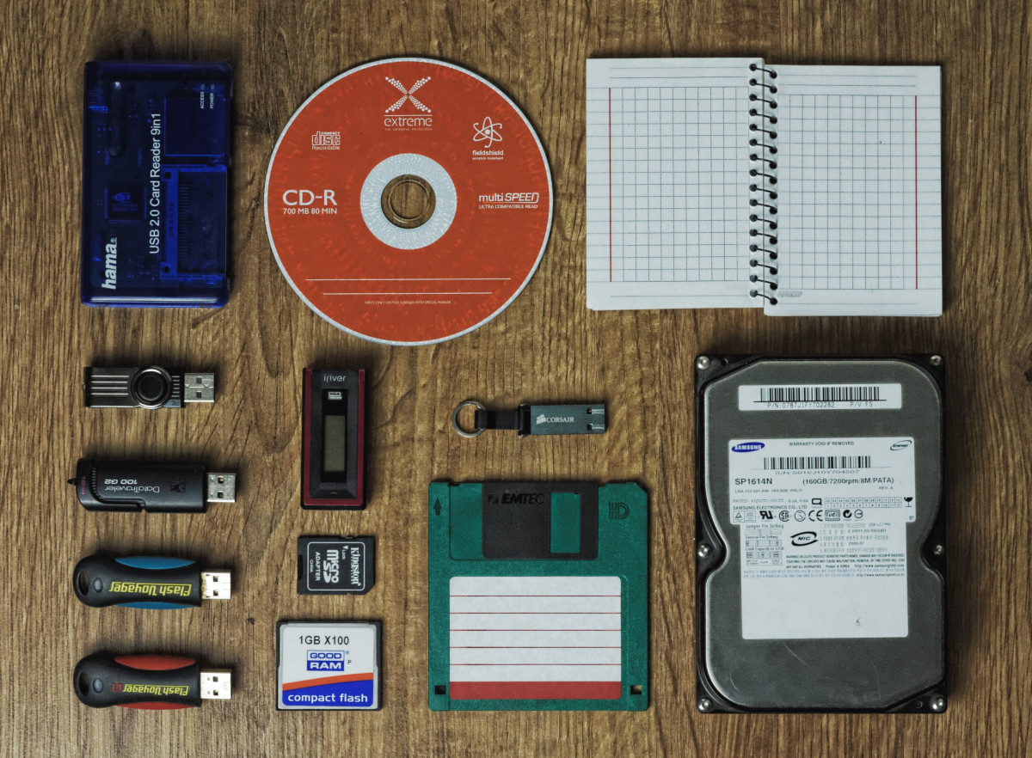
Backup & Restore Management (1 of 2)
What is Data Backup ?
A data backup is a copy of computer data taken and stored elsewhere so that it may be used to restore the original after a data loss
Why Data Backup?
Data backup is important because it protects against data loss

Slide 10
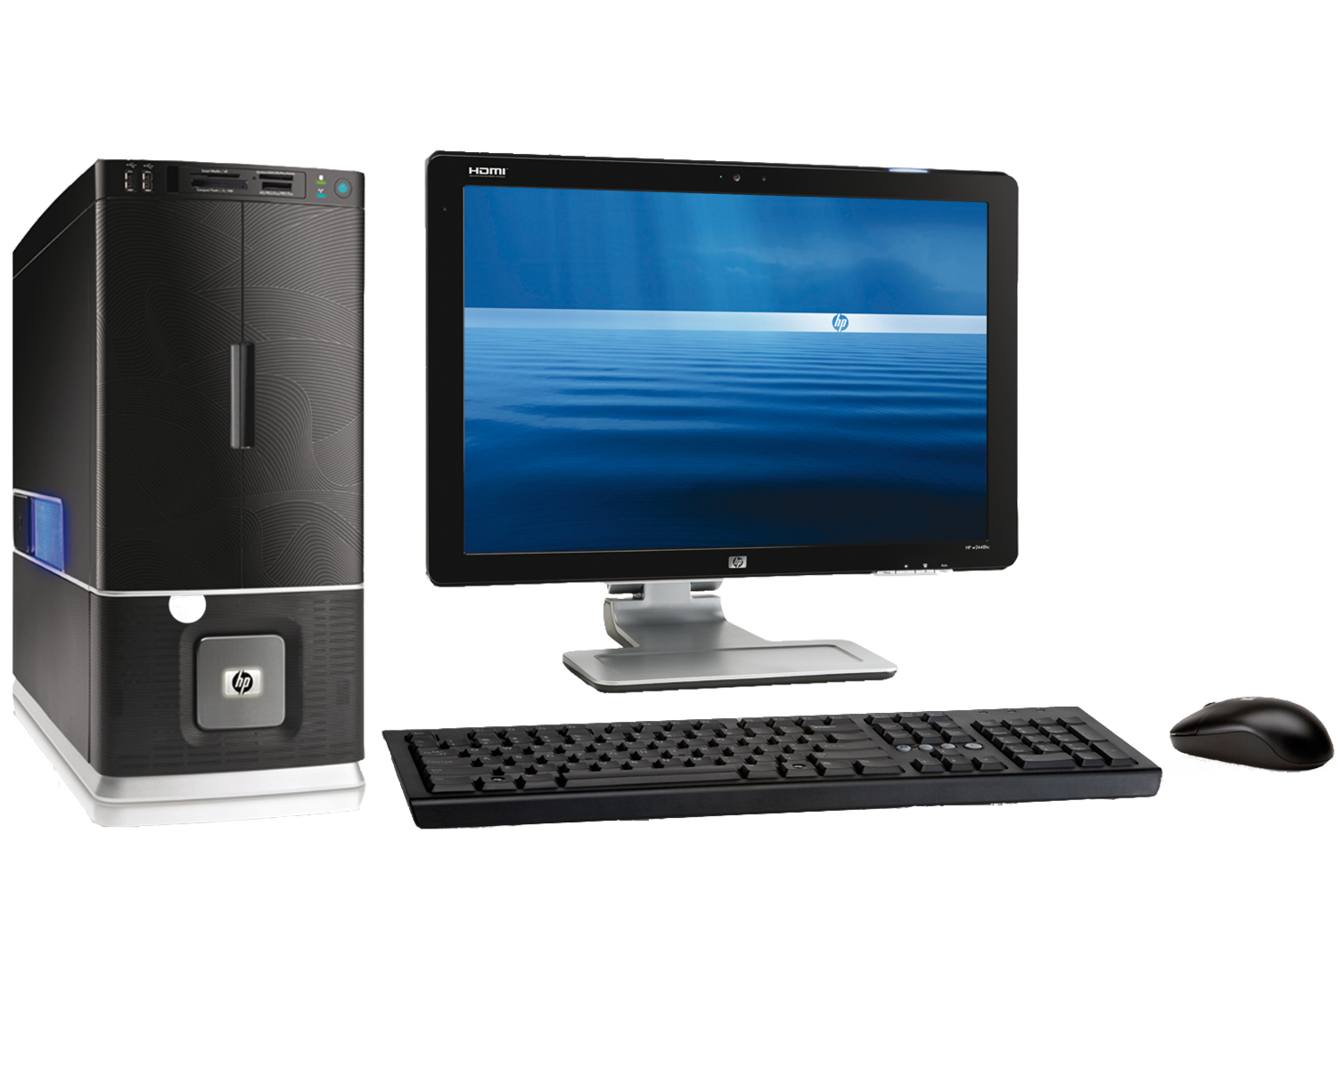


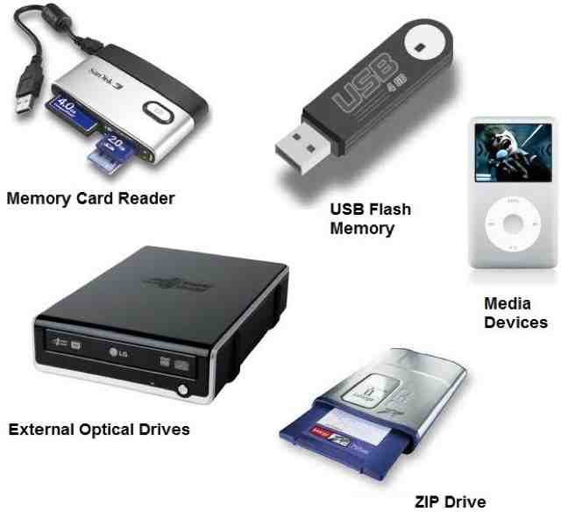


Backup & Restore Management (2of 2)
Data can be backed up in multiple ways
Local System
Through Network
External Storage such as Pen Drive, External HDD etc.…
Product Walkthrough
External Storage such as Pen Drive, External HDD etc.…
Data Backup on cloud

Slide 11
Top Queries in Backup/Restore
Unable to backup
Scenario : In case if the data is physically corrupted
Solution : Create a copy of data folder
Repair the data (https://help.tallysolutions.com/tally-prime/data-management/data-management-errors-resolutions/#1717678295476-68988e25-80b4)
Insert Disk 2 to while restoring the data
Scenario: Trying to restore an incomplete data backup or disk is full and then process is terminated
Solution: The data backup is not completely need to re enter the data in absence of earlier backup

Slide 12
Security Control

Slide 13

Security Control Management
What is Data Security?
Data security refers to the process of protecting data from Unauthorized access
Why is Data Security Required?
Confidentiality: Protects data from Unauthorized users
Availability: Guarantees that the data is available for authorized access

Slide 14





Security Features In TallyPrime
Setting up of Security
Voucher level Security
Tally Vault
Single Sign in for Companies
Change UserR
Change PassworD
Users and PassworD
User RoLes
PassWord Policy
User Management
TallyAudit Track the Voucher/Master History

Slide 15
Top Queries in Security Management
How to retrieve TallyVault Password
Solution: Retrieval of TallyVault password is highly impossible as this is an advance level of security(Data Security - FAQ | TallyHelp (tallysolutions.com))
How to/Want to removeTallyVault password
To removeTallyVault password open the company from click on ALT+K>TallyVault> https://help.tallysolutions.com/tally/tallyvault-for-company-tally/
How to retrieve the company password in case if the password is forgotten?
Super user password can be retrieved only in case if the user level password is available https://help.tallysolutions.com/tally/tallyvault-for-company-tally/
How to do Add new users
New users can be added From ALT+K > Users and Passwords> Add users (https://help.tallysolutions.com/tally-prime/access-control-data-security/manage-users-in-tallyprime/)

Slide 16
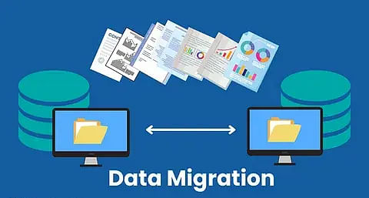
Data Migration
What is Data Migration ?
Process of changing data from older versions to TallyPrime. 3x
Why is Data Migration required ?
Compatibility of using earlier version/release data in TallyPrime latest release

Slide 17
Data Migration Product -Walkthrough
From 6.3/7.2 to TallyPrime 3.0/4.1
From Tally9/ERP to TallyPrime 3.0/4.1
TallyPrime Rel 1.0 till 2.1 to 3.0 and above
Data Migration using Tally72 Migration tool
From Tally9/ERP to TallyPrime 3.0 and above
From ERP to TallyPrime 3.0/4.1

Slide 18
Top Queries During Data Migration
How to /want to Migrate
https://help.tallysolutions.com/tally-prime/data-management/
https://help.tallysolutions.com/tally-prime/data-management/migrate-company-data-tally/
How to want to migrate the data
From 6.3/7.2 to Prime release 3.x
TE9/ERP9 to 3.x
Data specific issues
Data Specific issues
To address the exceptions from Gateway of Tally> ALT+Y> All Exceptions> Migration
Mismatch in Debit and credit
Ledger/Group/Stock Group/Stock Item etc.. Already exists/does not exist
Balance Mismatch related issues post migration
Data specific errors
Data specific errors
Data Migration taking time
Transactions/masters
Due to low system configurations
Memory Access Violation and other data errors
Taking time during migration depends on the following scenarios
System configuration
Data Size
For MAV and other Data errors https://help.tallysolutions.com/tally-prime/tally-company/memory-access-violation-faq/#1715943456695-7b977f52-e280

Slide 19
Data Split in TallyPrime
What is Data Split in TallyPrime?
Data Split in TallyPrime refers is a process of separating the data which will reduce the data size
Why is Data Split performed?
Secure old data and start working in new data.
Reduction in Data size which will help in improved data access performance.
Choice to use new financial year data with new data folder.
When data split should be performed ?
Once the company account is finalized (usually) this will be completed by sept or oct every year

Slide 20
Pre- requisites before split
Do’s | Don'ts
Data Split process should be taken up once after finalising the account books | Do not split the data before finalizing the books or during the beginning of new financial year
Ensure pre-split activities are through before proceeding with split process | Do not split the data before clearing the pending or tracking
Take up split process during off business hours or during weekends | Do not split the data while other users are working
Backup the existing data and Verify the data
Use high end configuration for data split process

Slide 21

Data Split Product walkthrough

Slide 22
FAQs at TallyCare

Slide 23
FAQs
01.
How to/Want to Perform Data Split ?
Step 1: Take the data backup
Step 2: Open TallyPrime and select the company(Data split company) ALT+Y> Company Data> Data Split> Verify
Step 3: ALT+Y> Company Data> Data Split> Split Data
Note: Ensure customer has followed presplit activity. Process the data in a high-end system
02.
How to Verify company data in TallyPrime before splitting the data ?
Step 1: Take the data backup
Step 2: Open TallyPrime and select the company(Data split company) ALT+Y> Company Data> Data Split> Verify

Slide 24
FAQs
03.
Once after data split process is through pending orders are not showing?
Solution : Before proceeding to split need to ensure that the pending orders are closed. Close the pending orders and then split the data
04.
Getting Memory Access Violation while splitting the data?
Solution: Take a data backup upgrade to the latest release and perform repair and split the data

Slide 25
FAQs
05.
I am not getting Data Split option?
Solution :Open company with super user level password and then check
06.
Data Split takes lot of time in my system ?
Solution: The speed at which the data gets split depends on the volume of the data and the configuration of your computer. We recommend that you split data on the local hard disk on a computer with a higher RAM.

Slide 26
Data Errors & Corruption

Slide 27
Data Corruption
What is Data Corruption ?
Why Data gets corrupted?
Ways to protect the data from corruption
Top Data corruption errors

Slide 28

Data Corruption
Data corruption refers to errors in computer data that occurs due to system failure/system issues
What is Data Corruption?

Slide 29


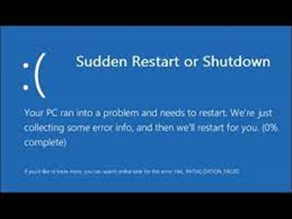
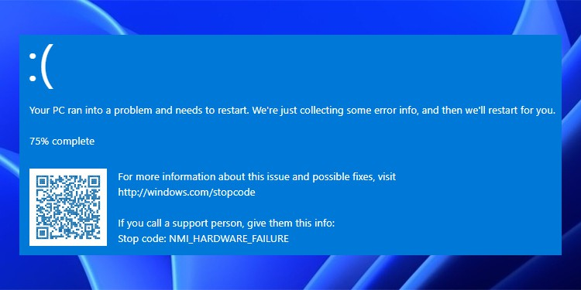
Why Data Gets Corrupted? (1 of 2)
Power outages
Malware
Computer viruses
Improper shutdowns
Hardware failures
Including hard drive failures
Bad sectors, Bad RAM

Slide 30
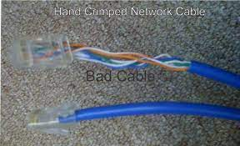
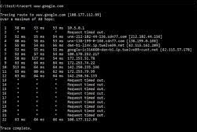
Why Data Gets Corrupted? (2 of 2)
Faulty cables/switches
Result in bad data transmission on the network
Corrupted LAN Cards on one or more machines on the network
Power outages & other power-related problems

Slide 31
Precautions to Avoid Data Corruption
Use best antivirus software in your system and always update it
Use security mechanisms to protect your data
Regularly troubleshoot application, system, and network-related issues.
Regularly back up your data to reduce the risk of data corruption

Slide 32

Data Self Recovery (Repair)
What is Repair ?
Data Repair is a process in TallyPrime that performs data re-building by removing corrupted data.
Simple Repair
In the Simple Repair method, Database is refreshed and rebuilt. This process is faster.
Forceful/Zero Repair
In the Forceful/Zero Repair method, the database undergoes additional validations to maintain consistency. This method is utilized when simple repair fails to rectify data errors.
Note: During data repair, corrupted masters/vouchers will be removed/deleted from the database. Details of vouchers retained/deleted will be logged in TallyPrime’ s Exceptions.

Slide 33
Top Data Errors
Memory Access Violation
While Opening Tally
While loading company
During Voucher entry/Reports
Error Transmgr/link/Manager.900/1800
While opening Tally
During Voucher entry/Reports
Error code 32
Company not listing
Unable to read message 0 for update

Slide 34
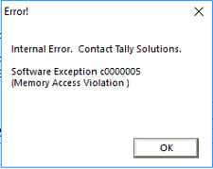
Memory Access Violation (MAV)
Memory Access Violation
While Opening TallyPrime
While Opening Company
While working/accessing data
Reasons: While opening Company
Reasons: While opening TallyPrime
Default company is set to “Yes”
Due to corrupted printer drivers
System related issues
Due to the data file size 1Kb
Data corrupted
Reasons: While working in TallyPrime
Data file size is 1Kb
Data corruption

Slide 35
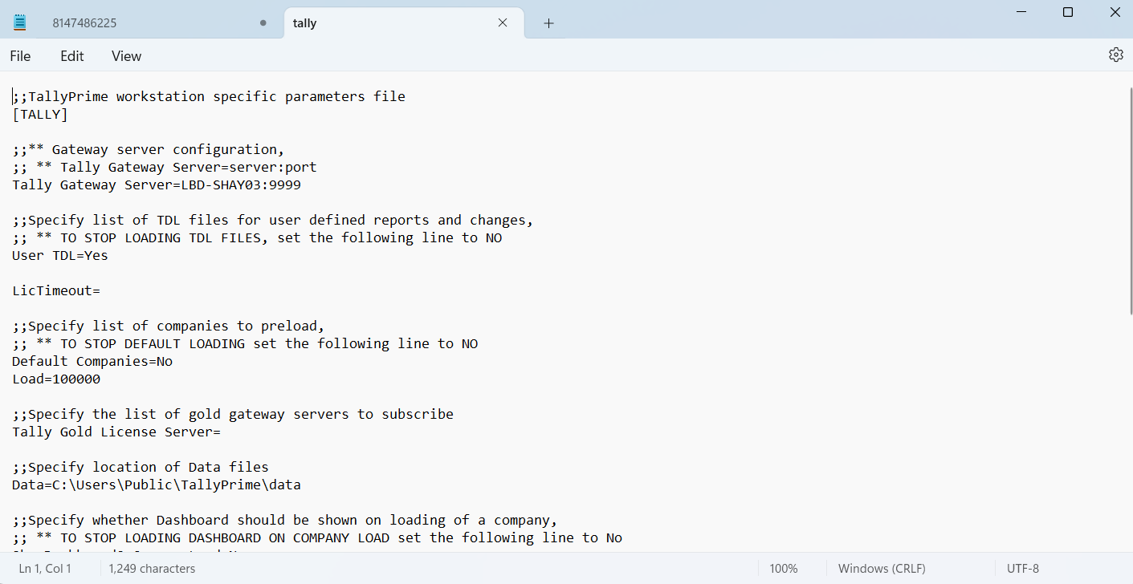
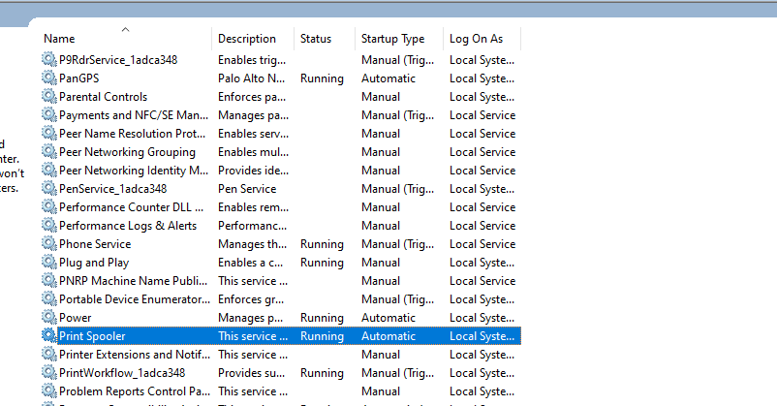
MAV While opening TallyPrime-Resolution steps
Default companies to “No” in Tally configuration settings
Stop the Printer spooler service from services screen

Slide 36
MAV While opening TallyPrime-Resolution steps
Check the file size of *.900/*.1800 files (Transmgr/Manager)
If the file size is 1KB, then restore the recent backup, if available, and continue
In case the file size is depending on data size
Repair the data using TallyPrime> About> Troubleshooting Repair
Note: Ensure that the existing data folder is copied before proceeding with Data Repair.

Slide 37
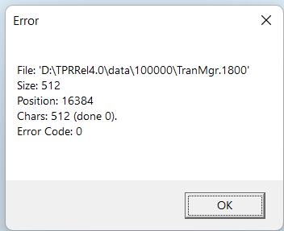
Error- Transmgr/linkmgr/manager
While opening the company
While working
In Server
In Server
Node/Client
Node/Client

Slide 38
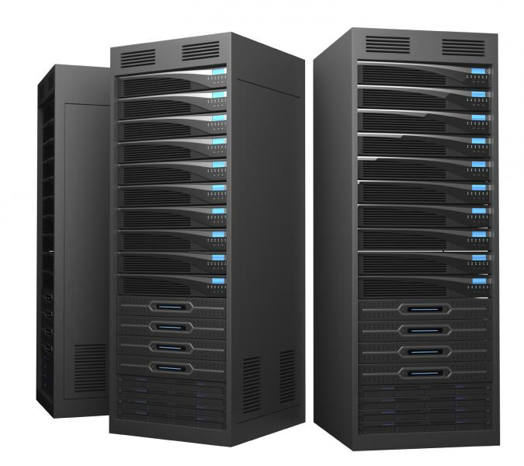
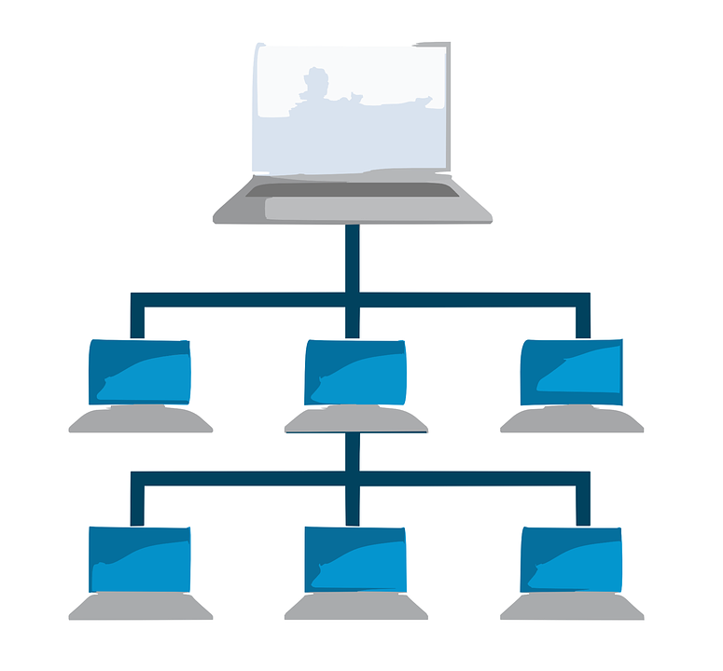
Error- Transmgr/linkmgr/manager- Resolution
In Server
While opening Company/While Accessing the data
Check the file size of Transmgr/Manager.1800/900
If the file size is 1Kb, restore the recent backup and continue your work
Restrict file deletion permission using Windows Security Settings
Repair the data in case the Transmgr.900 file is more than 1KB
While opening Company/While Accessing the data
Check the file size of Transmgr/Manager.1800/900
If the file size is 1Kb, restore the recent backup and continue your work
Restrict file deletion permission using Windows Security Settings
Repair the data in case the Transmgr.900 file is more than 1KB
Node/Client

Slide 39
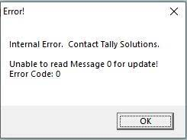
Error- Unable to Read message
Cause: When there is any physical damage to the TMessage.tsf files
Network issues
If the data is being accessed using WIFI
Ping speed has variations
Variation in the Network speed i.e., In case the Network speed is 100Mbps and 1Gbps
Different category of Network cables
Network speed
Resolution:
Use network monitor tools and keep a check on Ping speed
Recommended to have same Network speed instead of having different network speed
WIFI
Resolution-Do not Use WIFI network due to the latency
Network Cables
Resolution: Use same network category cables

Slide 40
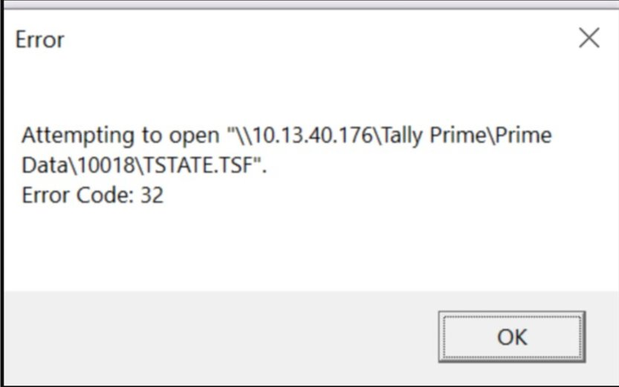
Error code 32
Trying to copy the data folder when it is in use
Due to third party backup tools
Reason
Add *.tsf file extensions in the external backup tool
Do not copy the data when it is in use
Solution

Slide 41



Company Data is not listing in Server/Client
Due to System issues
Due to windows user security
Virus/Malware

Slide 42
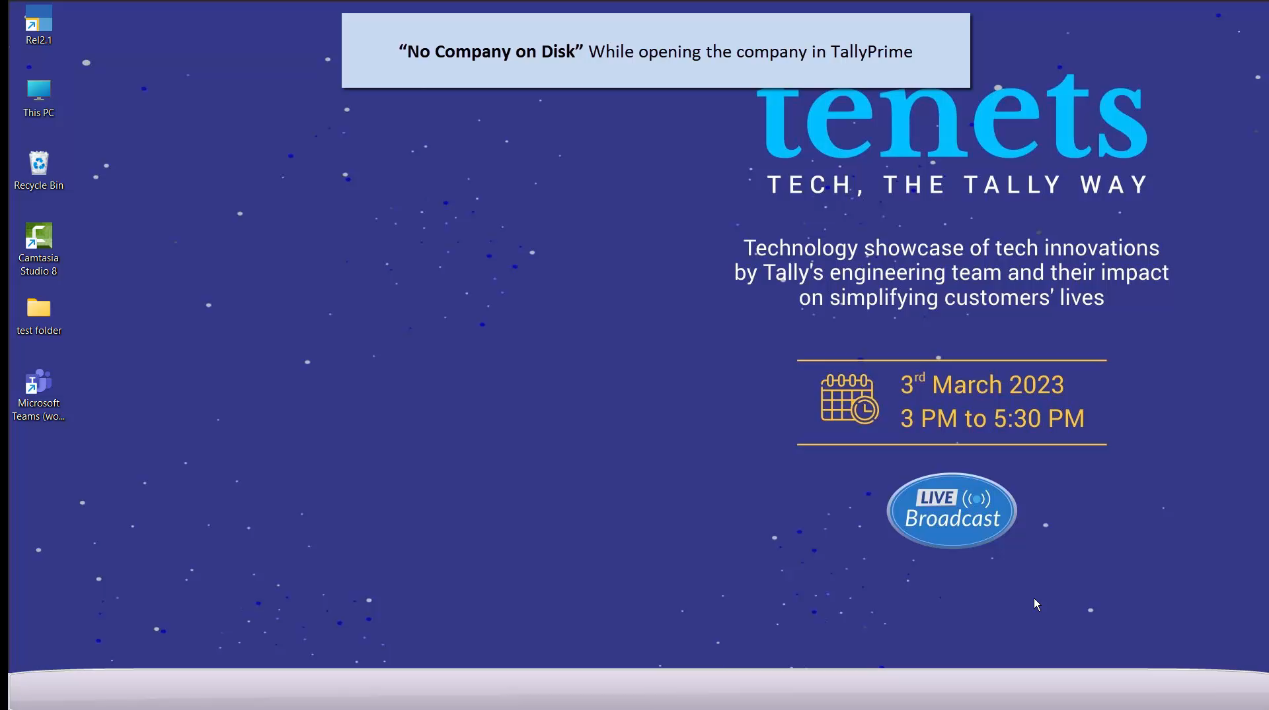
Company Data is not listing in Server/One user due to restriction

Slide 43
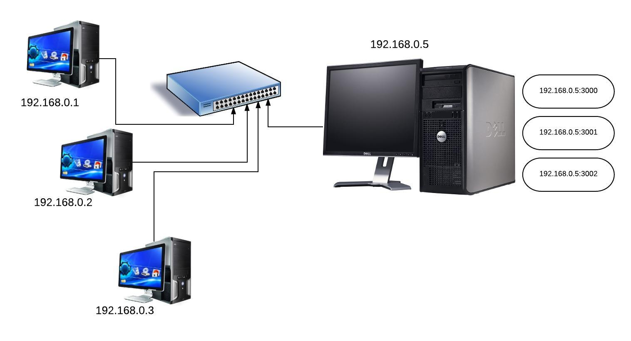

Company Data is not listing in Node/Client due to Network
Network disconnection
Check the connection between Server and Client and vice versa
Update the network drivers in case of network issue
Need to update the network drivers (with the consent of the system administrator)
Network login credentials
To check the consistency i.e. is user able to connect server system from client by providing the system credentials

Slide 44
Company Data is not listing in Server/Client -System issues/Virus Malware
Bad sectors and HDD issues
Perform chk disk from command prompt and get the HDD defragmented with the consent of the system administrator
Bad RAM
Get the RAM replaced with the consent of the system administrator
Other System issues
Address the system related issues with the consent of the administrator
Virus/Malware
Use the updated version of Antivirus software
Stay away from opening malicious content/email
Data to be backed up continuously

Slide 45
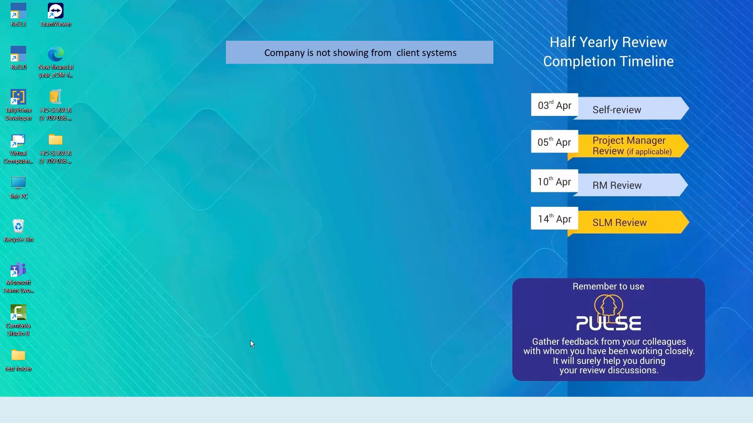
Company Data is not listing in Node/Client due to restriction

Slide 46
Q&A

